Slide 1
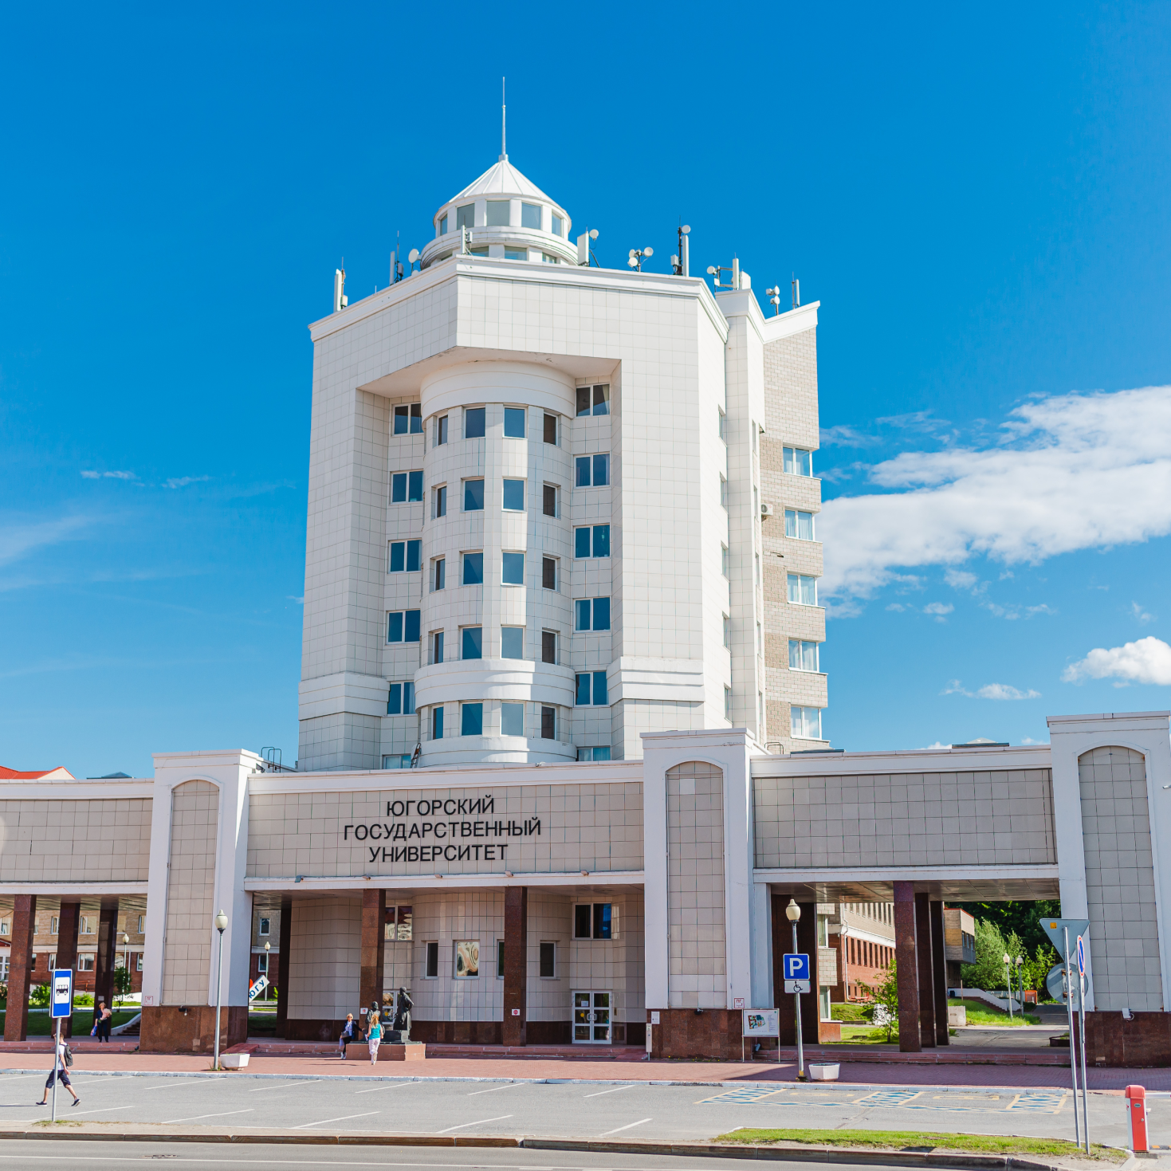
About University
Full name: Federal State Budgetary Educational Institution of Higher Education
“Yugra State University”
Short name: Yugra State University(YuSU)
Foundation date
OCTOBER 5TH
2001

Slide 2
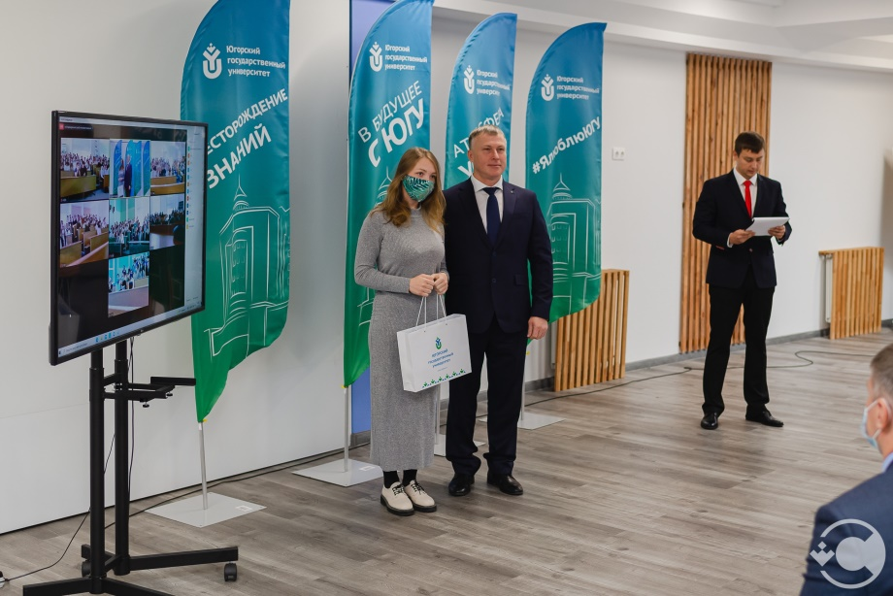
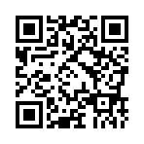
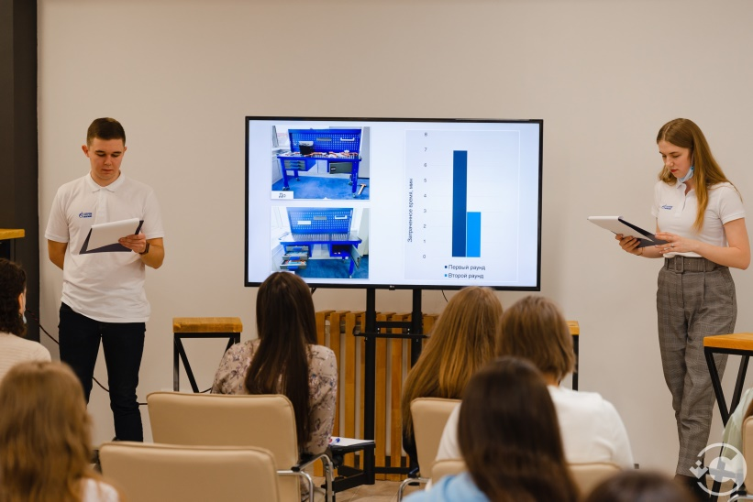
WE ARE LEADERS!
YuSU is a leading university on the market of education of Khanty-Mansiysk Autonomous Okrug - Yugra, it provides all levels of professional education: :
secondary vocational
undergraduate
graduate and post-graduate degree programs
Each year over 2,000 specialists graduate from the university and get employed by regional companies.
TOP OF10
12
14
77
4+1
40+
In the Ural Federal District
scientific schools
laboratories
educational programs
Institutes and Center of Excellence
International partners

Slide 3
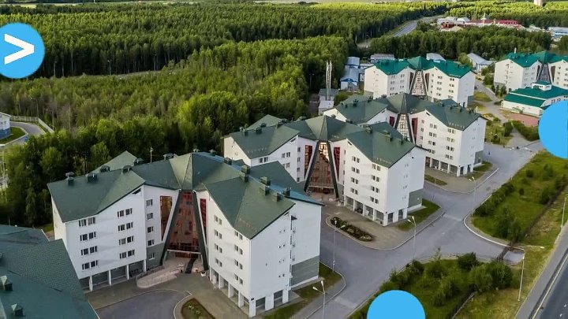
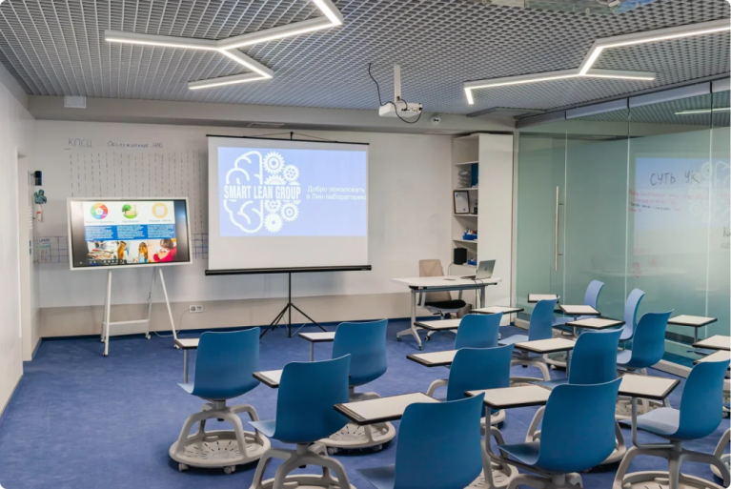
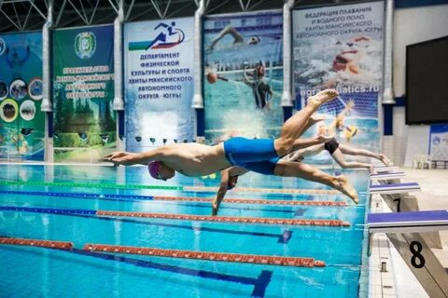
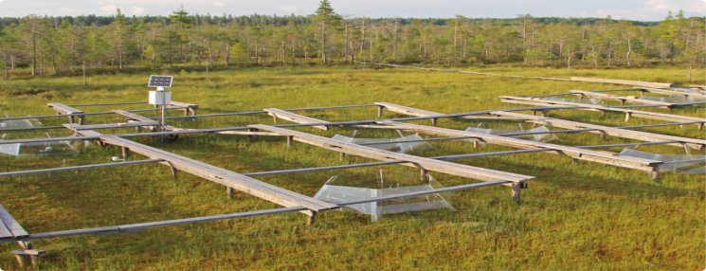
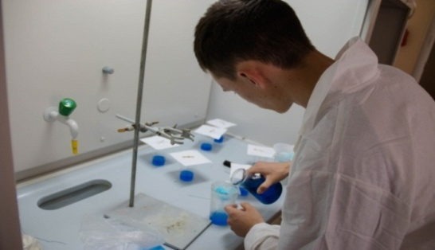
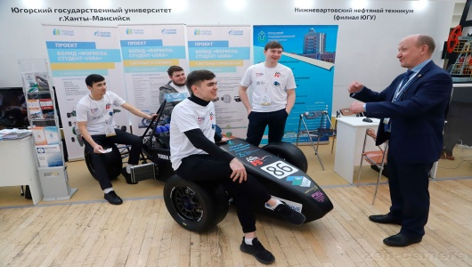
What do we offer
- Living in a modern safe town which took one of the leading positions in the rating for the quality of life of the population in Russia;
- High-quality education in 77 programs;
- Modern campus with comfortable dormitories;
- “Digital university”;
- World class sport complex;
- UNESCO Chair “Environmental dynamic and global climate change” with International field station;
- Laboratory complex;
- Developed partnership with industrial partners and governmental bodies;
- Extra curricular activities: adaptation program, language school, dance club, sports club, vocal studio, studio of modern choreography, theatre-studio, research communities, student construction offices (ex. Formula Student Ugra).

Slide 4
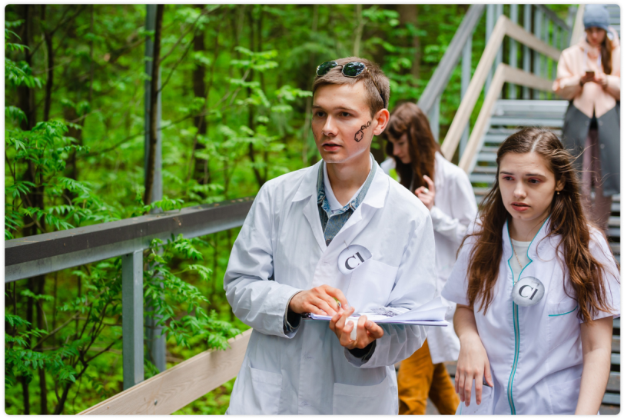
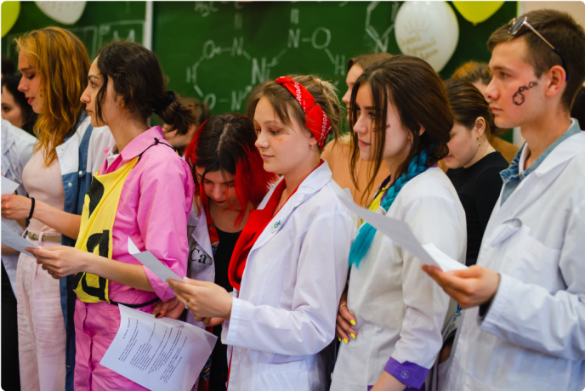
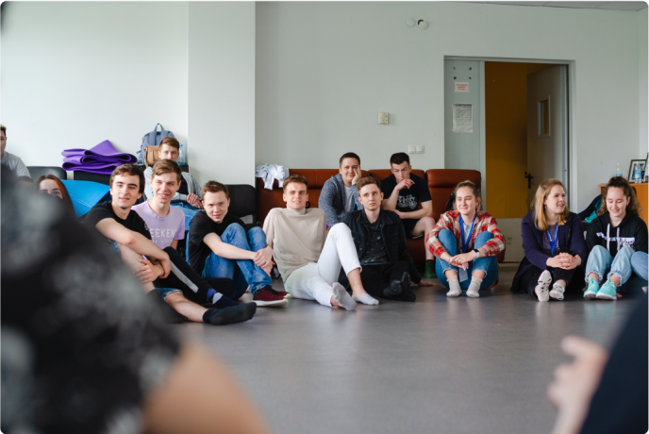
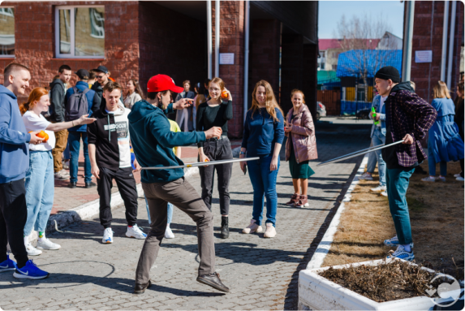
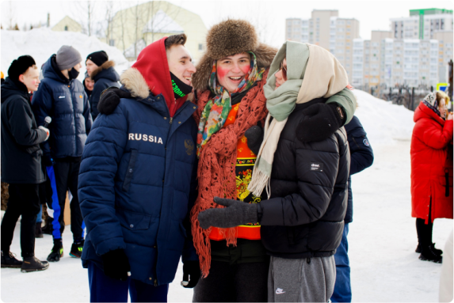
>10 000
>300
> 200
students
teachers
international students
EDUCATION (in Russian language)
The university has a modern technical base and developed infrastructure
4 institutes:
Humanitarian Institute
Institute of Oil and Gas
Institute of Digital Economy
Law Institute
1 Center for Excellence:
Ugra Green School: YES (Yugra. Environment. Skills)

Slide 5
Russian as a foreign language program in 5 academic fields:
Russian as a foreign language program in 5 academic fields:
Russian as a foreign language program in 5 academic fields:
Preparatory course – “Standard”: Preparatory course – “Intensive”:
Period of study: October – June Period of study – December – June/February - August
Application dates: March 1–October 1 Application dates –March 1–December 1
Training period: – 9 months Training period – 7 months
Total number of academic hours: – 2376, Total number of academic hours: – 2376, including
including 1008/1010 classroom hours 1056/1134 classroom hours
Tuition fee: 1500-1700 $ (depending on academic field). Discounts to be discussed.
Preparatory Department

Slide 6
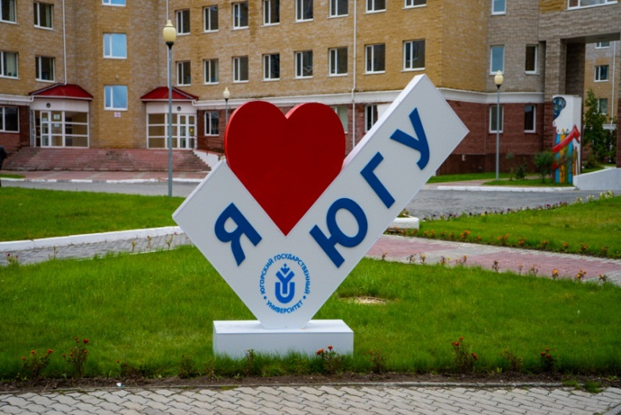
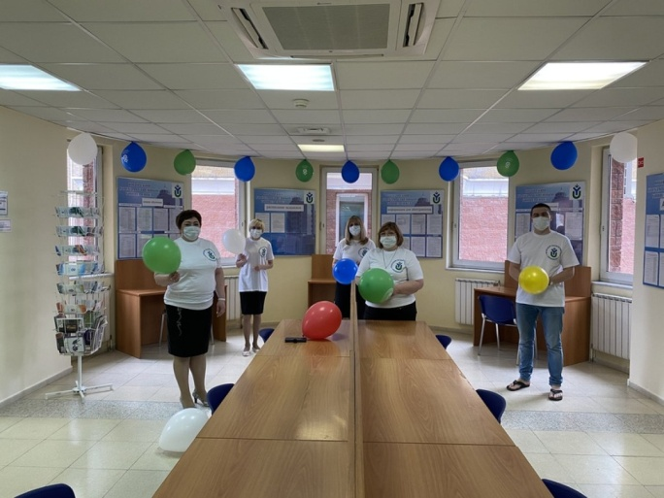
How to be admitted to Yugra State University
No tuition for:
Foreign citizen of following categories:
а) Citizens of any country applying within the quota established by the Government of the Russian Federation (without any competition). To apply within the quota, please, visit https://education-in-russia.com for more information.
b) Citizens of Republic of Belarus, Republic of Kazakhstan, Kyrgyz Republic, Republic of Tajikistan (participation in the general competition). c) Citizens of the Republic of Armenia, the Republic of Moldova, the Republic of Uzbekistan, Ukraine, Georgia, the Republic of Azerbaijan, Turkmenistan, and the Republic of Estonia having a residence permit in the Russian Federation (participation in the general competition).
d) Compatriots living abroad (participation in the general competition).
Tuition for:
Foreign citizen of other categories
More details here: https://www.ugrasu.ru/enrollee/

Slide 7
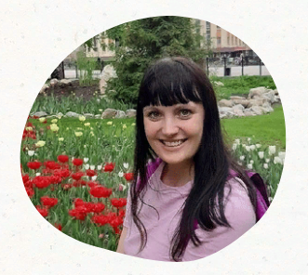
Contacts for admission:
Oksana Gololobova
Head of Center for International Cooperation
ugrasu.international@gmail.com
o_gololobova@ugrasu.ru
Tel. +79825544517 (WhatsApp)

